Slide 1
CAKERS Cake at your doorstep…..
by Sagar Deshmukh

Slide 2
Introduction
Cakers is a local mobile application that is transforming the shopping experience for people by connecting them to local cake stores.

Slide 3
Key Features
Select cake.
Check availability with the cake distributors listed with our app.
Choose celebration materials through app(candles etc.).
Payment Mode(Online)-Paypal, Card, etc.
Delivery Address/Store Pick-Up

Slide 4
Development Tools Used
The Cakers App would be developed in XCODE-IOS Platform.
The Supported devices are: Iphone 4s,5s,6,6s.
Testing of the App would be done using Selenium.

Slide 5
Understanding the App
Home – This is the home page of the application.
Choose Cake – Brings you to a screen (i.e. See slide #6.) that shows various cakes being sold at various prices by a wide variety of companies.
Payment & Delivery – Brings you to a screen (i.e. See slide #7.) that gives a wide variety of payment and delivery options.
Cart - Allows you to see the items you have chosen so far.
Contact Us – Contains contact information to be used for reaching customer support.
“Try our today’s best offer” – Link that displays the day’s current special offer. For example, on one day, there might be an offer stating that the user can buy one cake and get another cake free.

Slide 6
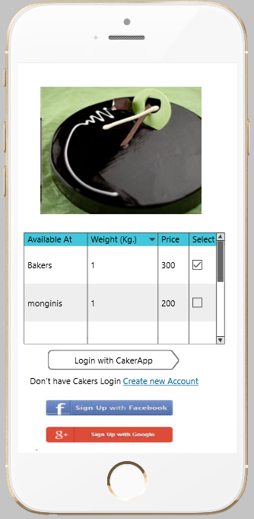
Availability with stores
The Cakers app shows available cakes in the most nearest and available/accessible stores.
After selecting a store, do either one of the following:
Create new Account – Create a new account to be stored on the app. This requires entering your name, telephone number, and email address.
Login with CakerApp – Login using an existing account stored on the app itself.
Sign Up with Facebook – Login using a Facebook account.
Sign Up with Google – Login using a Google account.

Slide 7
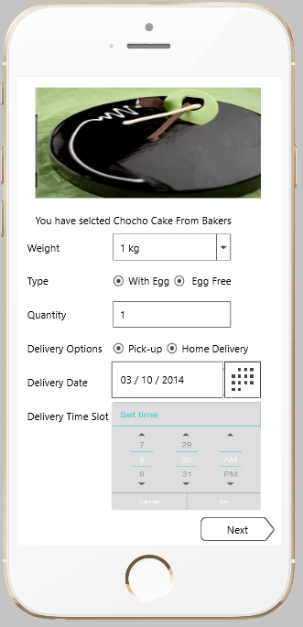
Delivery Options
Weight-Customer can select the quantity of the cake according to their needs.
Customization of quantity can also be requested by special request.
Type-Two type of Cake flavours are available:with Egg and Without Egg
Delivery Options-Pickup or Home Delivery
Delivery Date-Maximum prior order date is 10 days
Delivery Time Slot-Customer can select the time slot for that cake delivery
Next – Brings you to the next screen (i.e. See slide #8.)

Slide 8
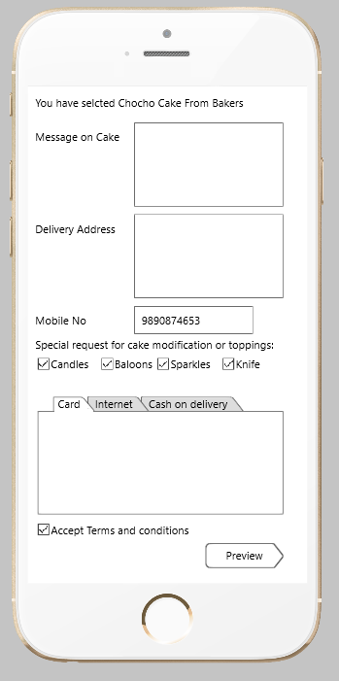
Delivery Options (cont’d)
Message on Cake-Customer can request the birthday bees name.
Delivery Address – Customer states the address to which the cake is to be delivered.
Mobile No – Customer states his mobile phone number.
Special Request-Additional items can be requested such as candles, baloons, sparkles, knife.
Card, Internet, Cash on Delivery – Customer decides to either pay with a card, pay through his personal website, or pay upon receiving his product.
Accept Terms and Conditions – Customer agrees to mandatory terms and conditions that need to be obeyed in order to utilize the Cakers app.
Preview – Customer goes to a screen where he gets to go over his entire order before confirming it.

Slide 9
THE END

